Slide 1
XG Boosting
XGBoost is a gradient boosting algorithm that is widely used in data science. It is an implementation of gradient boosting that is designed to be highly efficient, flexible and portable.
The algorithm was designed with the following goals in mind:
To be highly efficient
To be flexible
To be portable
XGBoost has been shown to outperform other machine learning algorithms in a variety of tasks, including classification, regression and ranking.

Slide 2
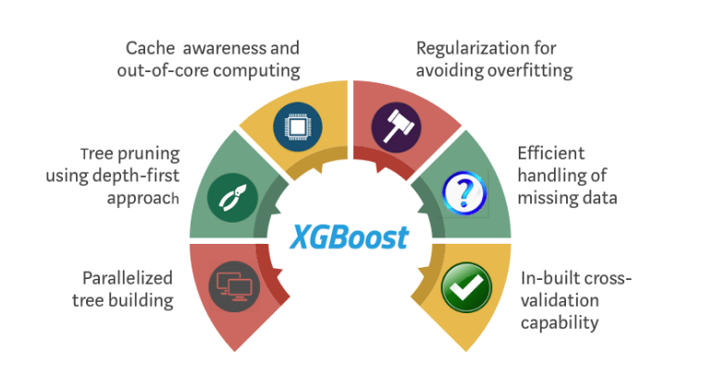
Features of XGBoost

Slide 3
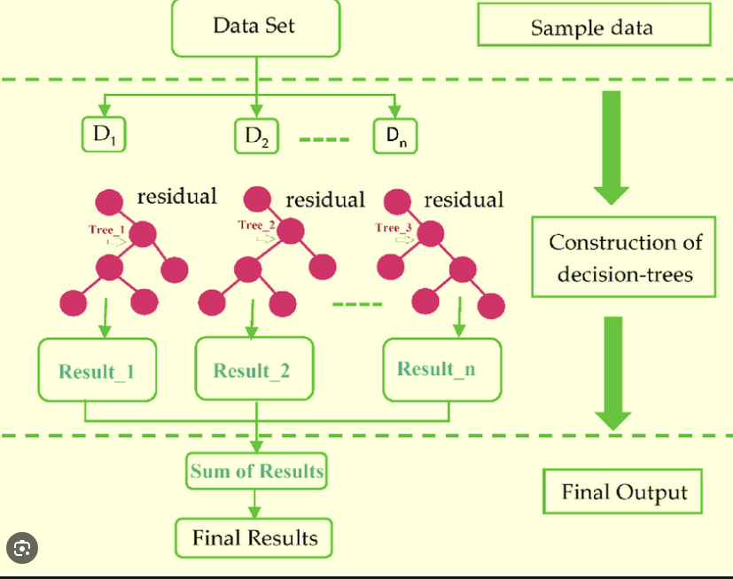
Features of XGBoost

Slide 4
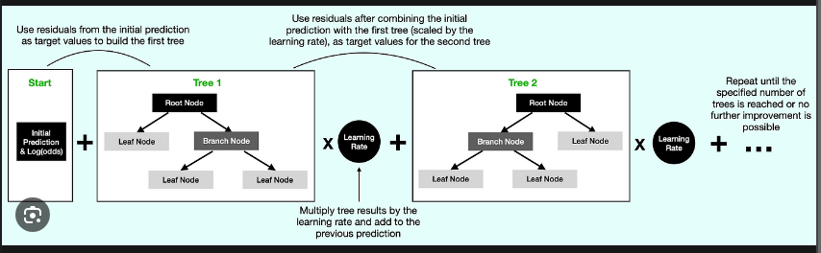
Residual Residuals are computed based on the predicted value and the observed values. A decision tree is created with the residuals using a similarity score for residuals. The similarity of the data in a leaf is calculated, as well as the gain in similarity in the subsequent split.

Slide 5
XGBoost works by training a number of decision trees. Each tree is trained on a subset of the data, and the predictions from each tree are combined to form the final prediction.

